Slide 1

Deep Learning Crash Course
Hui Xue
Fall 2021
www.deeplearningcrashcourse.org

Slide 2

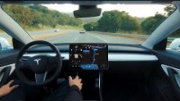
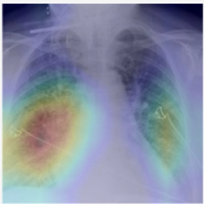
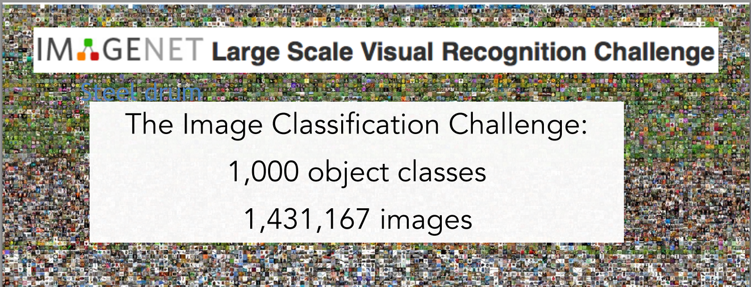
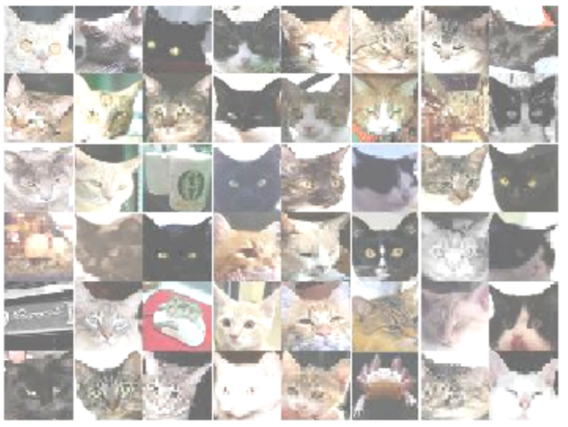
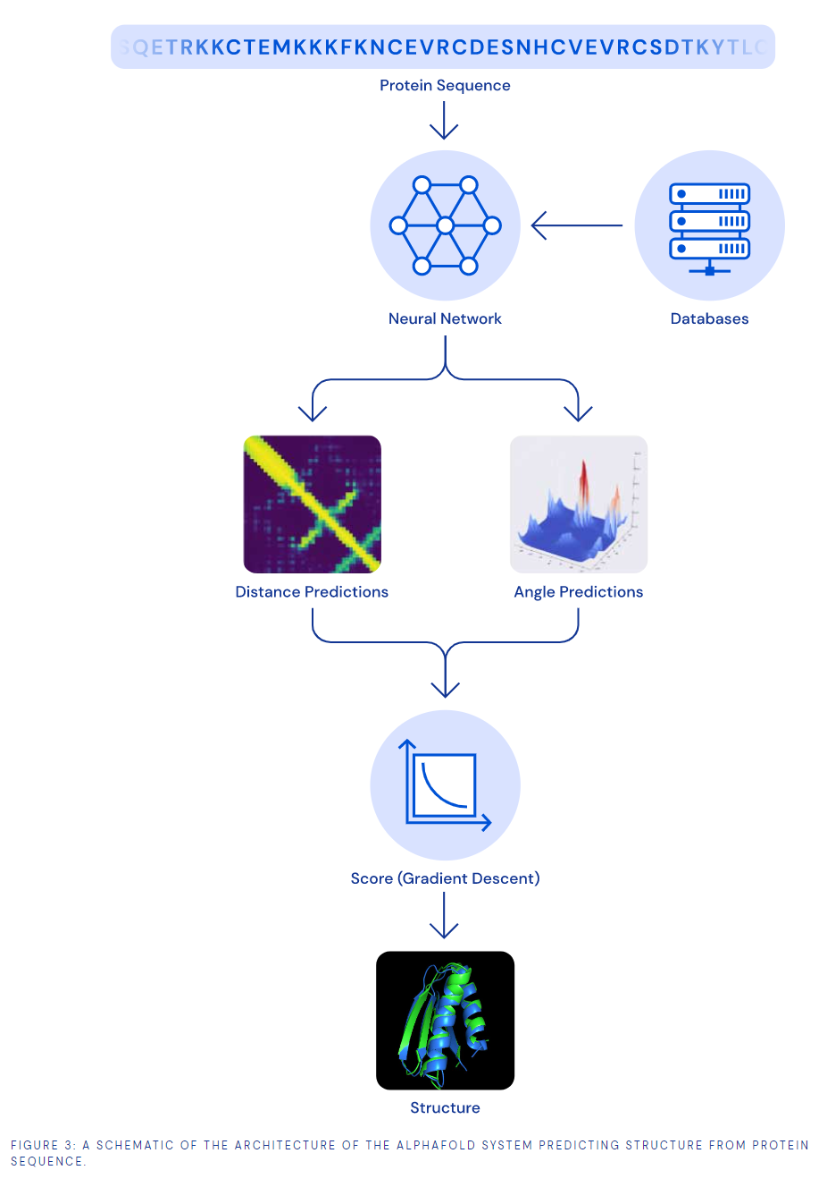
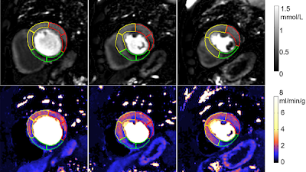
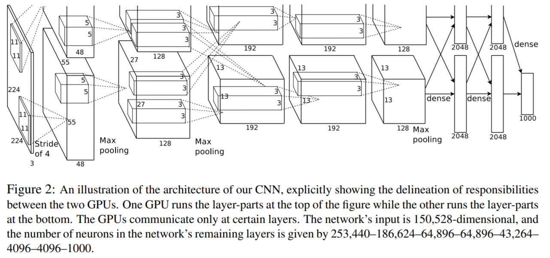
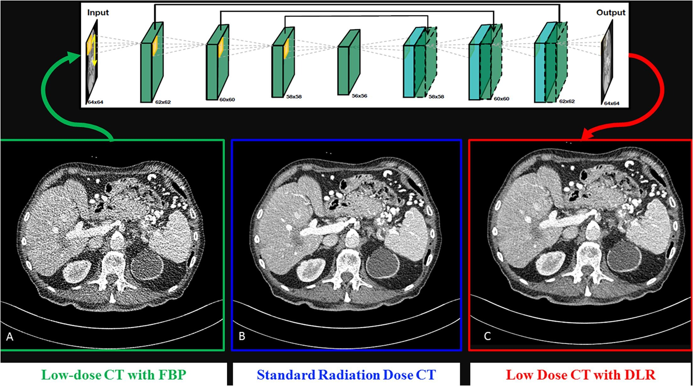
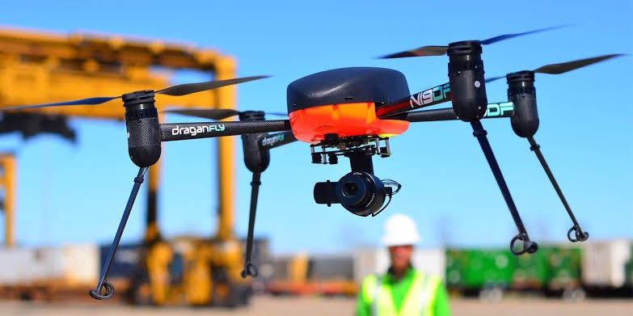
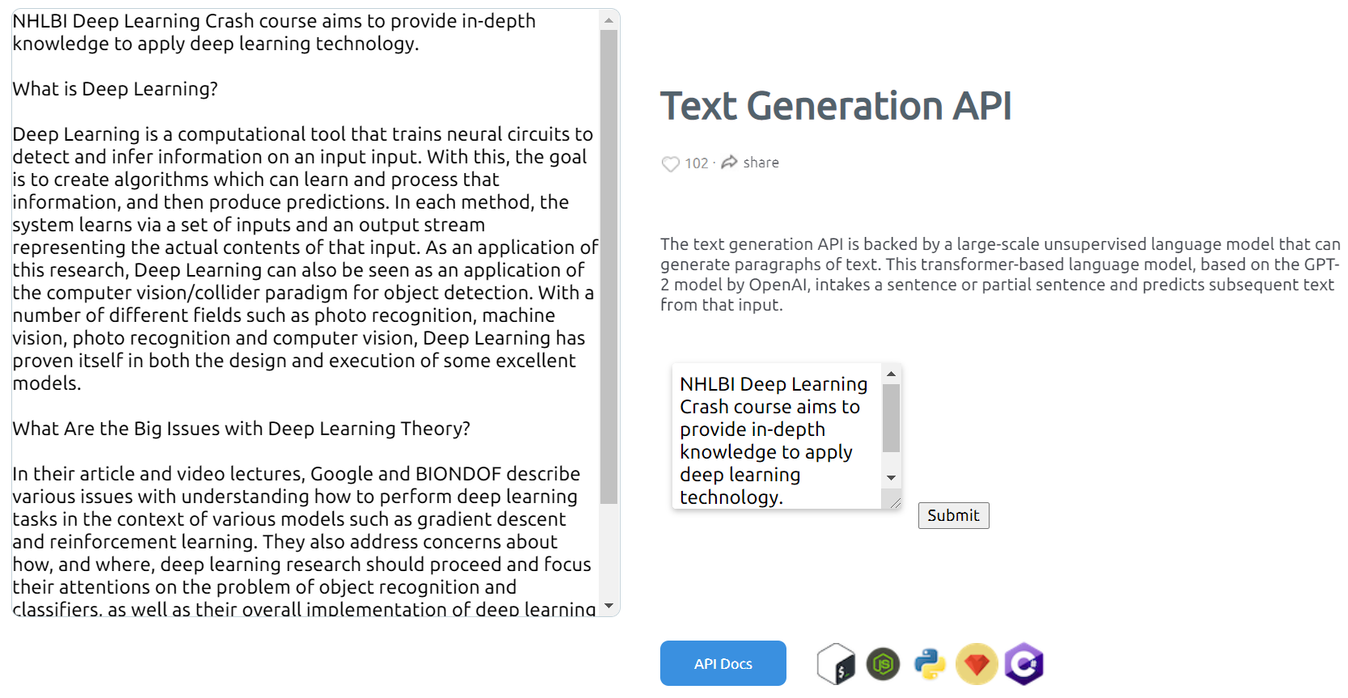
Deep Learning (DL) is making impact in many fields
https://www.youtube.com/watch?v=tlThdr3O5Qo
https://pubs.rsna.org/doi/10.1148/ryai.2021190228
https://pubs.rsna.org/doi/10.1148/ryai.2020200009
Alex net
Google Cat Study -
1000 computers with 16000 cores to recognize human faces, cat faces, human bodies etc. 2012.
https://deepmind.com/blog/article/AlphaFold-Using-AI-for-scientific-discovery
https://github.com/cs231n/cs231n.github.io
https://www.sciencedirect.com/science/article/pii/S1120179720302866?via%3Dihub
https://dl.acm.org/doi/10.1145/3065386
https://arxiv.org/abs/1112.6209
Deep Learning is one set of core technique which can serve many purposes …
https://medium.com/vsinghbisen/how-ai-based-drone-works-artificial-intelligence-drone-use-cases-7f3d44b8abe3
https://deepai.org/machine-learning-model/text-generator

Slide 3
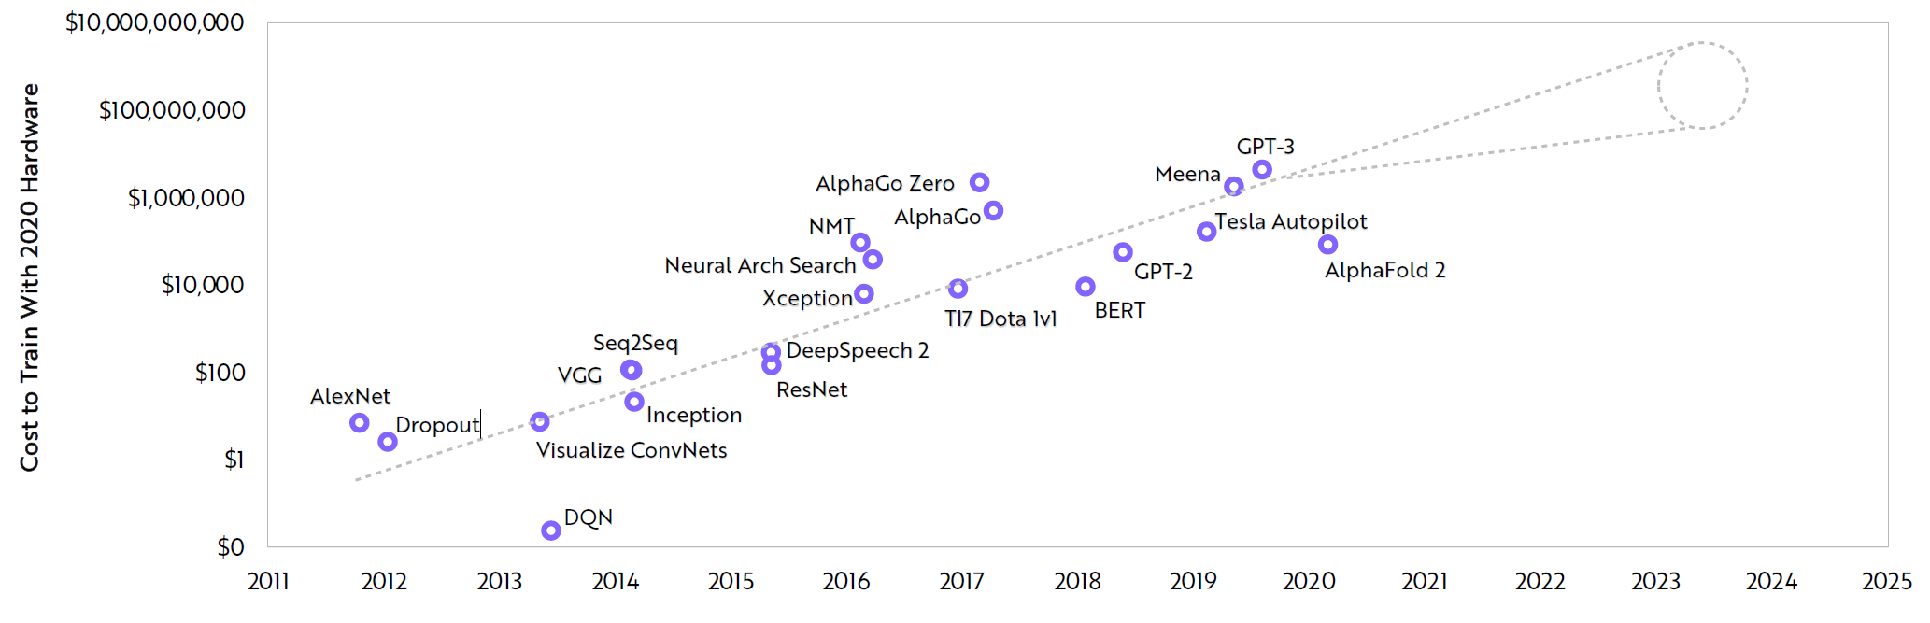
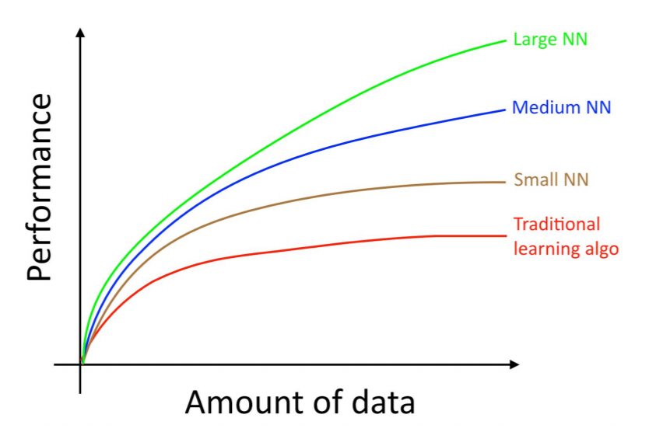
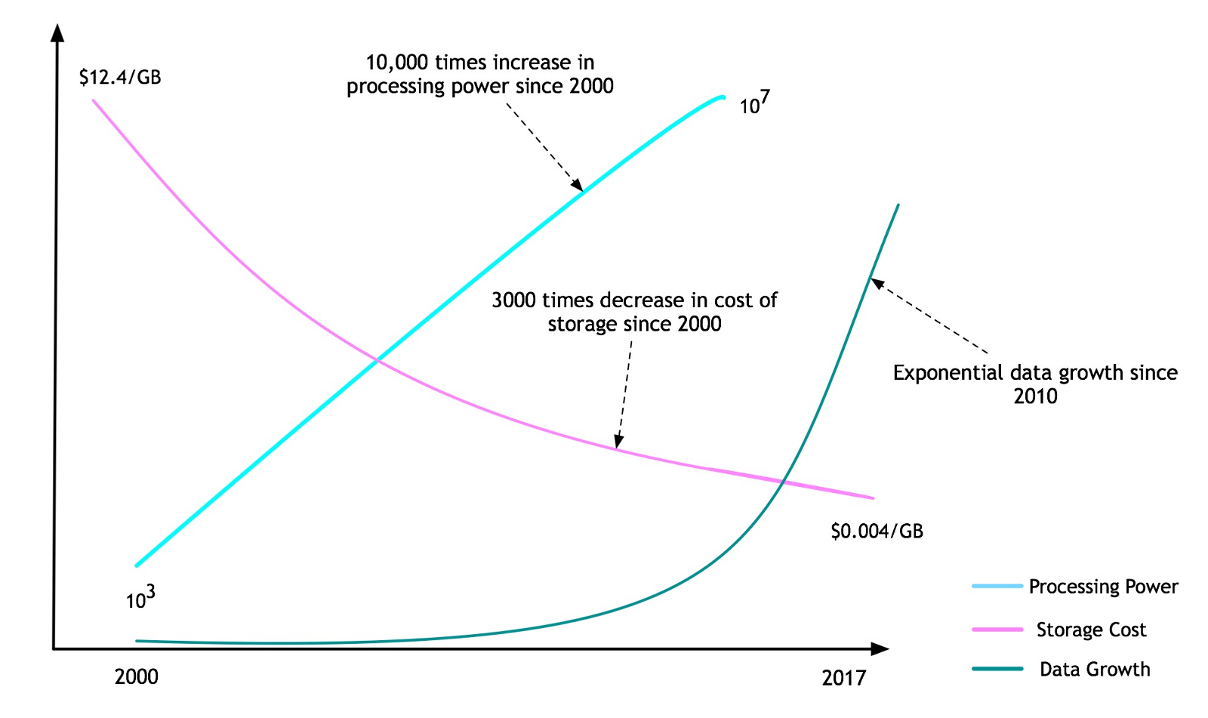
A combination of Data, Computing, Algorithm, Applications
So far, overall effect is higher training cost
Model size increases ~10x per year + Data size increases
Computing power
Bigger/better model
Why deep model is inevitable
Data
Machine Learning Yearning,

Slide 4
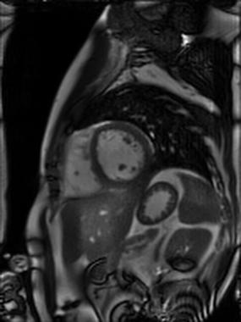
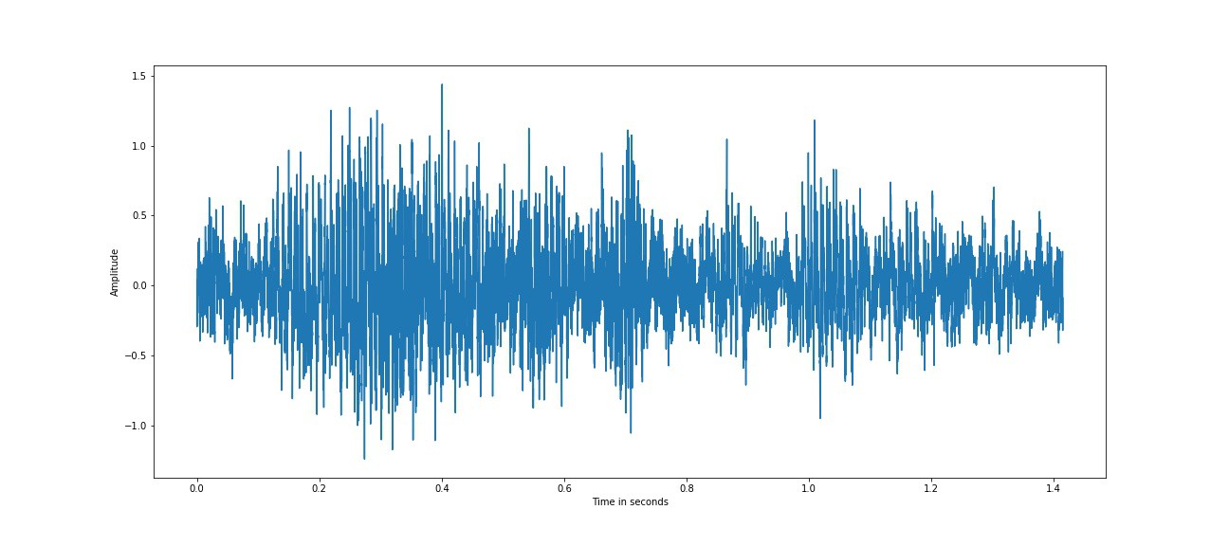
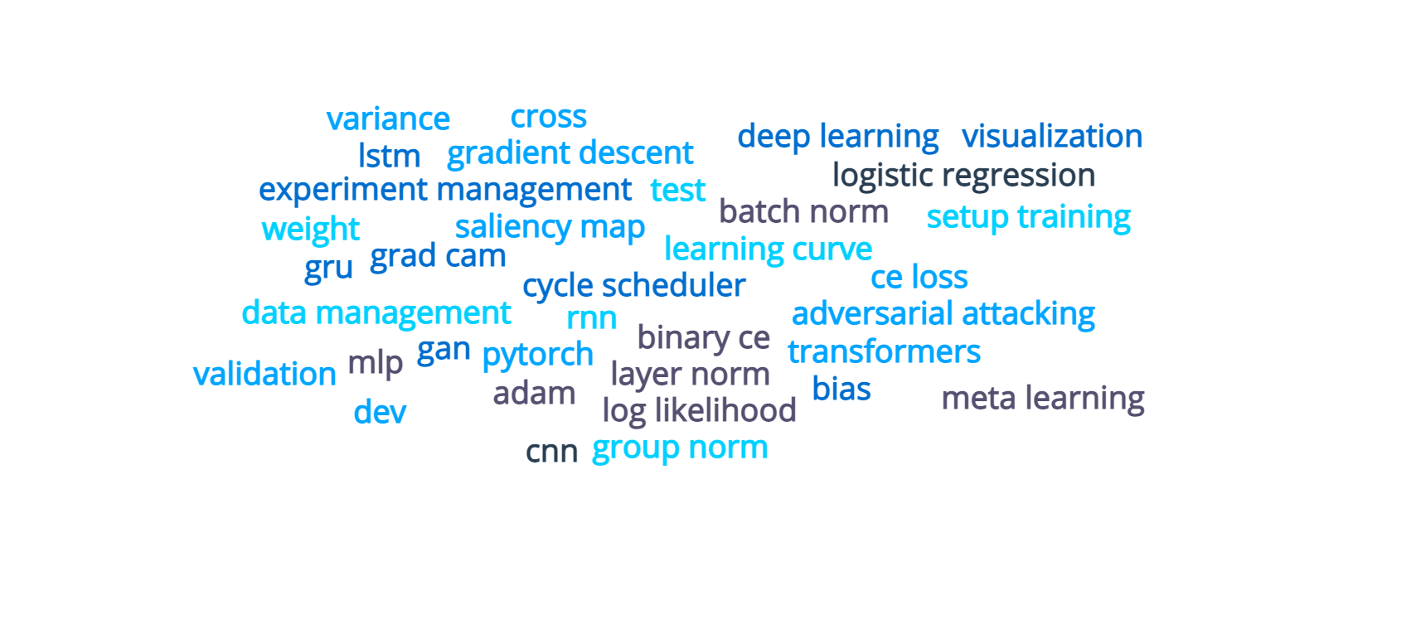
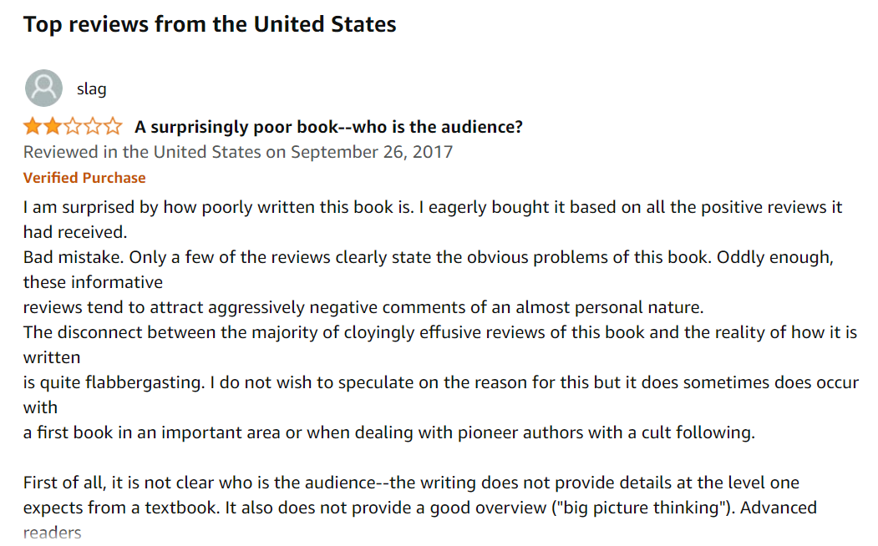
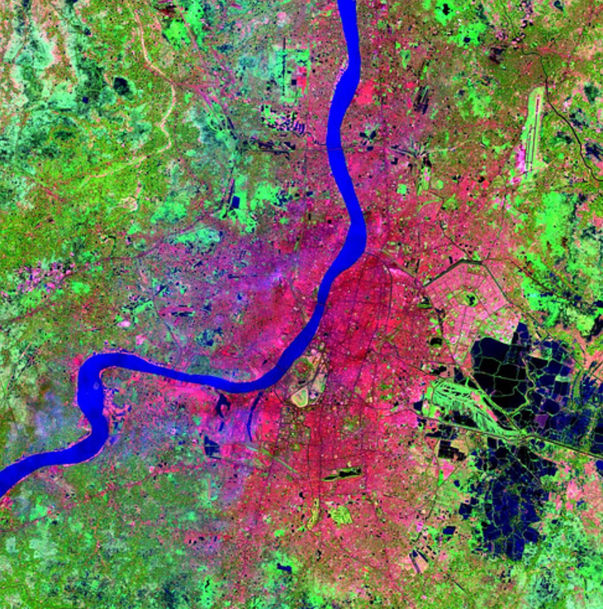
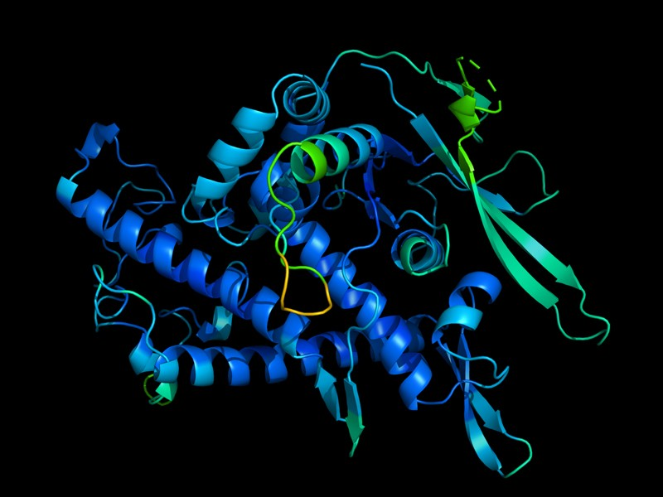
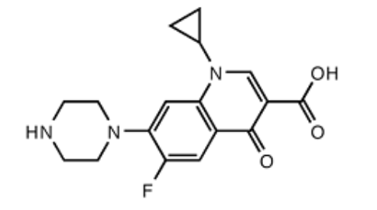
Why learn DL: same technology, widely applicable
Multi-modality data
Automation
AI assistant
Prediction
High duration system with 0% down time
Super-human performance in some applications
… still rapidly evolving
We will learn what is in the deep learning toolbox
https://www.nature.com/articles/d41586-020-03348-4
https://towardsdatascience.com/review-deep-learning-in-drug-discovery-f4c89e3321e1

Slide 5
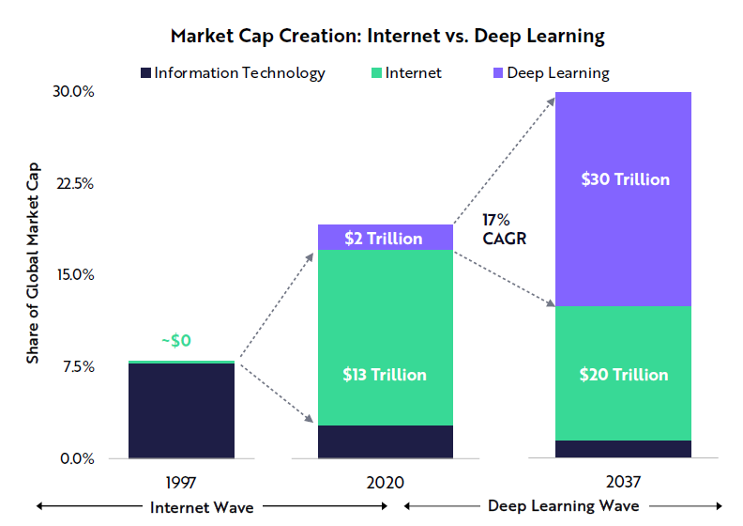
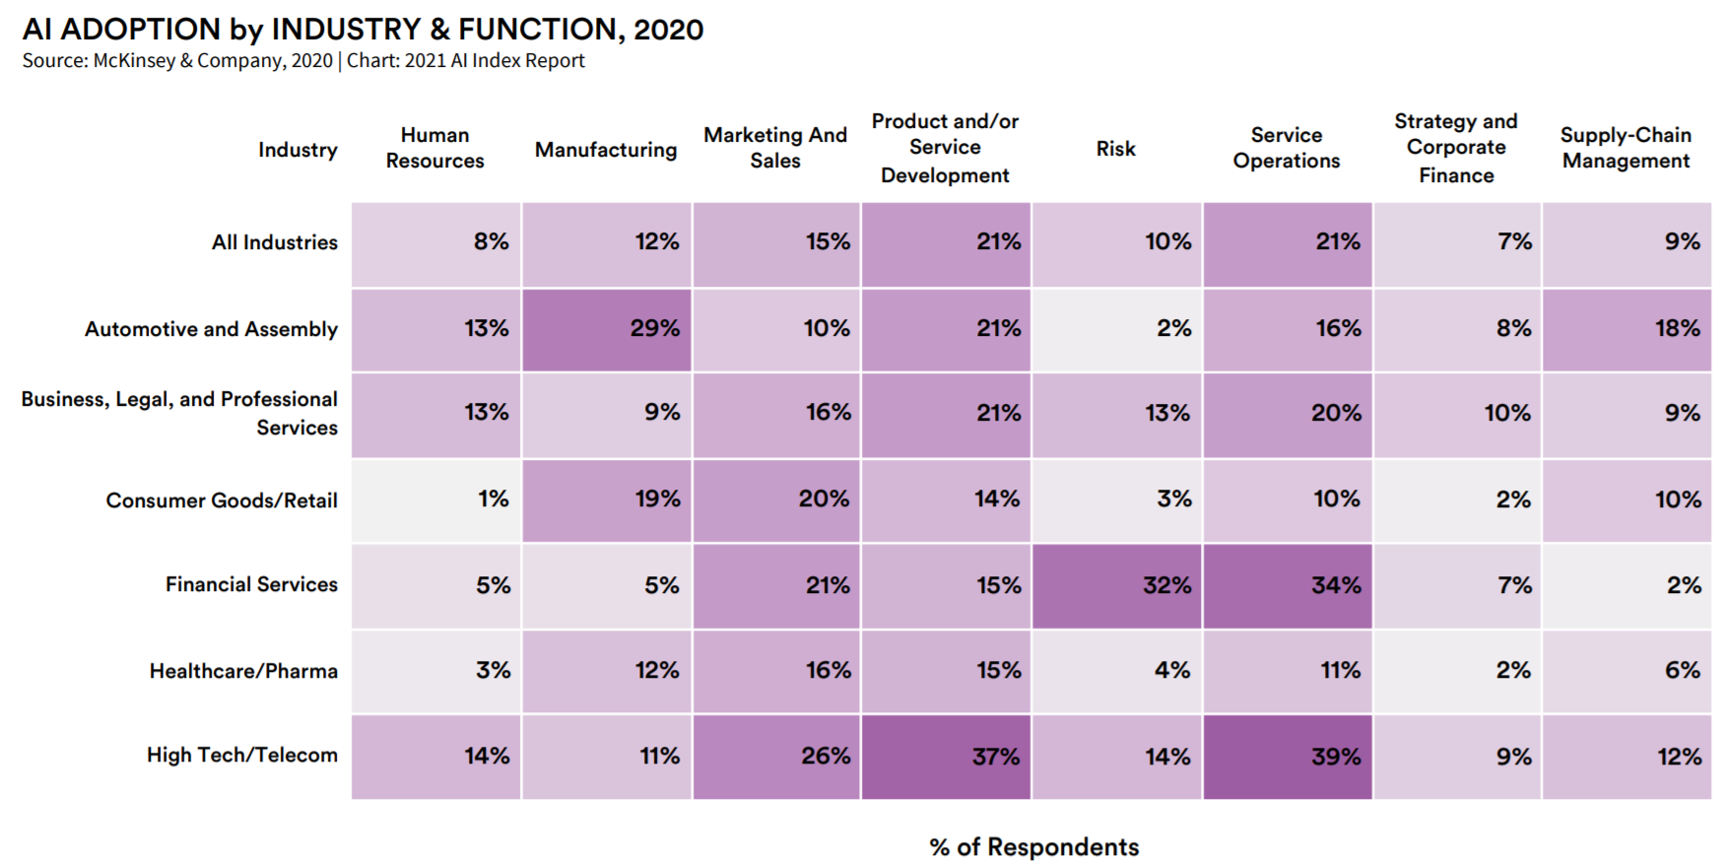
Bright future with a long-way to go: not too late to get in
From a McKinsey survey to state whether AI has been adopted in at least one company function
According to ARK's research, deep learning will add $30 trillion to the global equity market capitalization during the next 15-20 years.t
-- Big Idea 2021, https://ark-invest.com/big-ideas-2021/
https://aiindex.stanford.edu/wp-content/uploads/2021/03/2021-AI-Index-Report_Master.pdf
Just 16 percent of respondents say their companies have taken deep learning beyond the piloting stage.
Adoption of DL has a long-way to go and requires innovation.

Slide 6
What we want to achieve
Introduce the basics of deep learning
Present in-depth how DL model works
Provide practices to build your own model
Grow interest and improve community awareness
Prepare trainees and fellows for DL related jobs
👏After this course and assignments, start to apply DL to your field …

Slide 7
For 2021 Fall offering
Course logistics

Slide 8

Information and Course Resources
Website – www.deeplearningcrashcourse.org
Discussion – Slack channels
Assignment – Slack channels, you should receive invitation already!
Office hours – Announced on course website and slack
Course instructors:
Hui Xue (hui.xue@nih.gov)

Slide 9
More information
For this offering – www.deeplearningcrashcourse.org/nhlbi2021
Detailed introduction for every lecture
Reading list
Information for Setup
https://deeplearningcrashcourse.org/setup_ubuntu/
https://deeplearningcrashcourse.org/setup_win10/
Tech review session as we go
Require to know python programming
Will demo some basics and how to debug the code
GPU resources
Good news! If you need a GPU computer, we will provide ab Azure VM with 2x 1K80 GPU
Email hui.xue@nih.gov

Slide 10
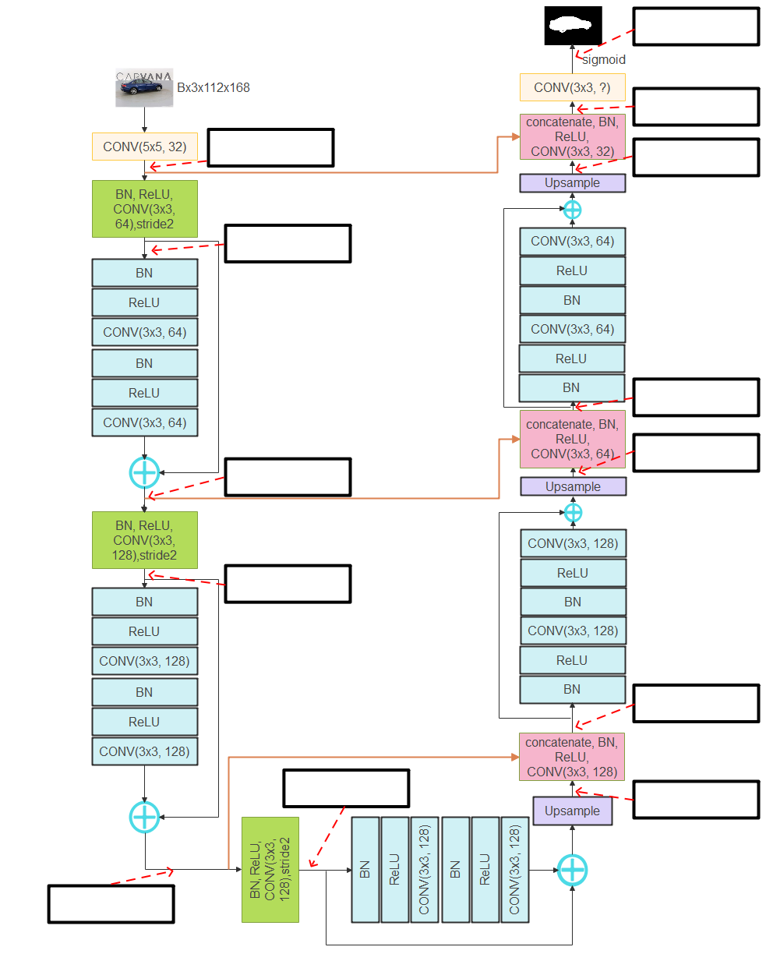
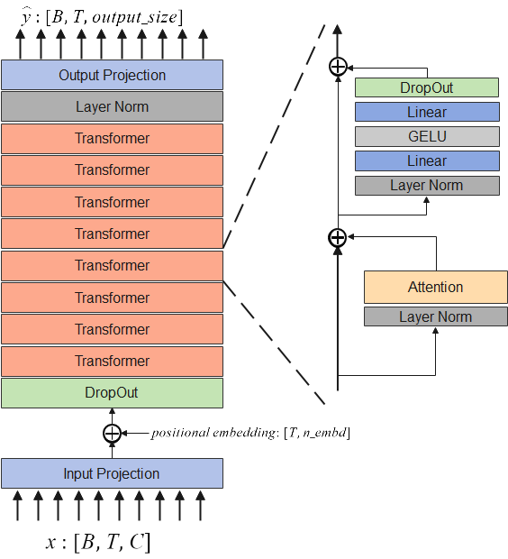
Assignments
Five assignments
A1 | Neural Network basics, Multi-layer Perceptron, Gradient descent
A2 | Backprop, Hyperparameter searching, Setup training, Pytorch
A3 | CNN, model training, Segmentation
A4 | RNN, Attention, Transformer
A5 | Model saving, saliency map, Adversarial attack, GAN, Transfer learning, Meta Learning
Many coding problems
Tooling for testing, experimental management, hyper-parameter searching …

